Slide 1
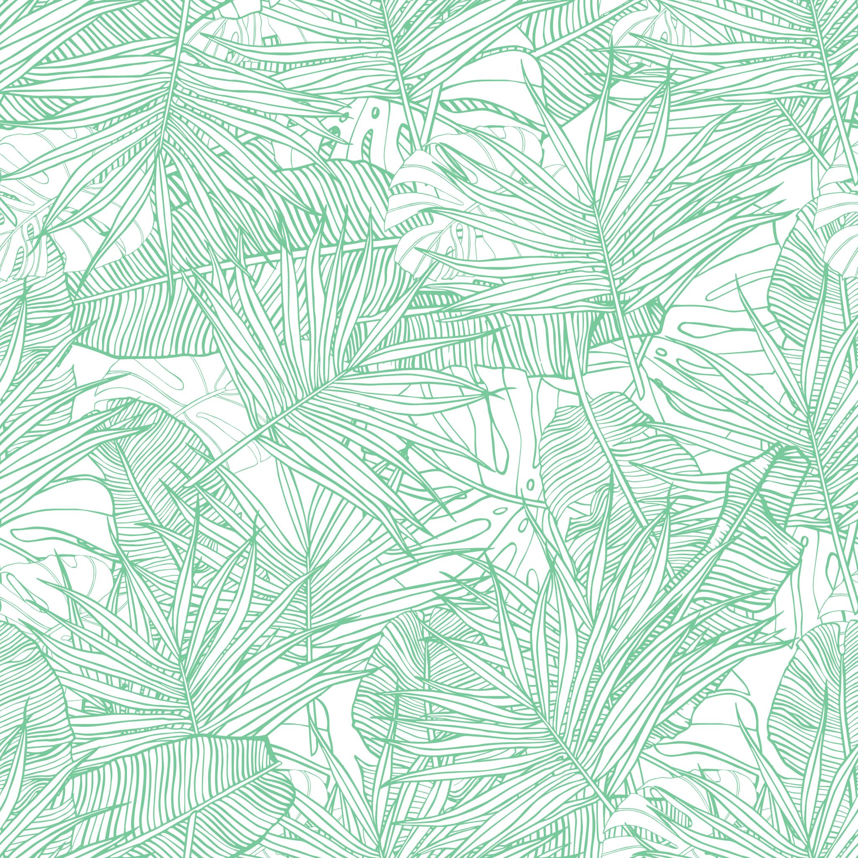
We helped our enviroment!

Slide 2
Hiking and cleaning
A group of 7th grade students from Ivanec went hiking on the Ivanščica mountain. On their trip they saw how nature should not look like. There was trash and garbage all along the path. The decision was made to help their environment by cleaning it.
After they were finished they wanted to rase awareness, so they wrote essays and made online posters

Slide 3
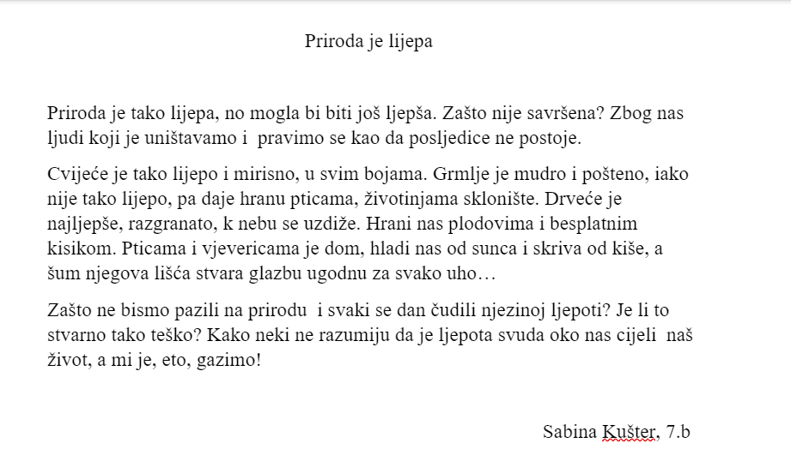
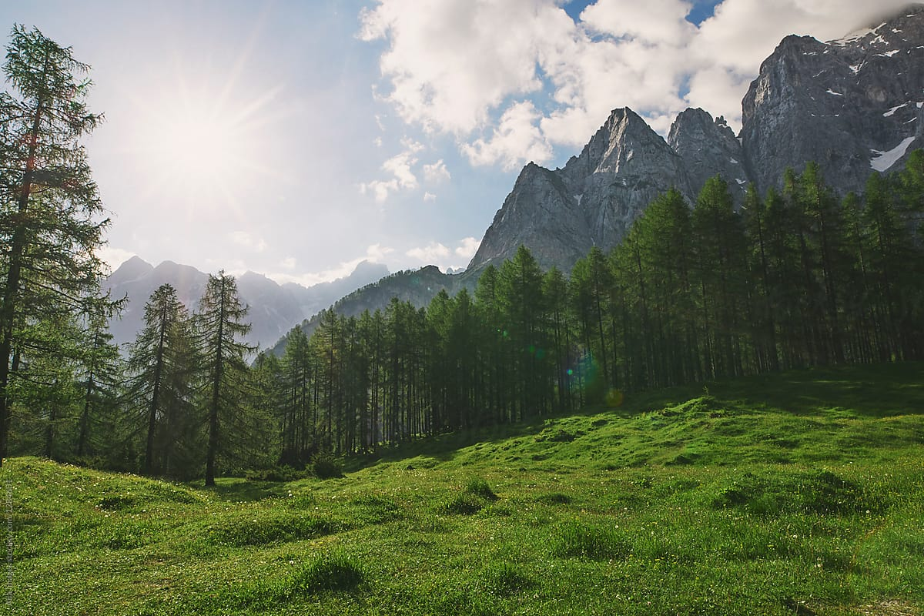
Nature is beautiful
Nature is so beautiful, but it could be even more beautiful. Why isn't it perfect? Because of us people who destroy it and pretend that there are no consequences.
The flowers are so beautiful and fragrant, in all colors. The bush is wise and fair, though not so beautiful, but it gives food to birds, shelter to animals. The trees are the most beautiful, branched, rising to the sky. It feeds us with fruits and free oxygen. Birds and squirrels are home there, it cools us from the sun and hides us from the rain, and the noise of its leaves creates music pleasing to every ear…
Why not take care of nature and marvel at its beauty every day? Is it really that hard? Some of us do not understand that beauty is all around us our whole life, and we are treading on it!
Sabina Kušter, 7.b

Slide 5
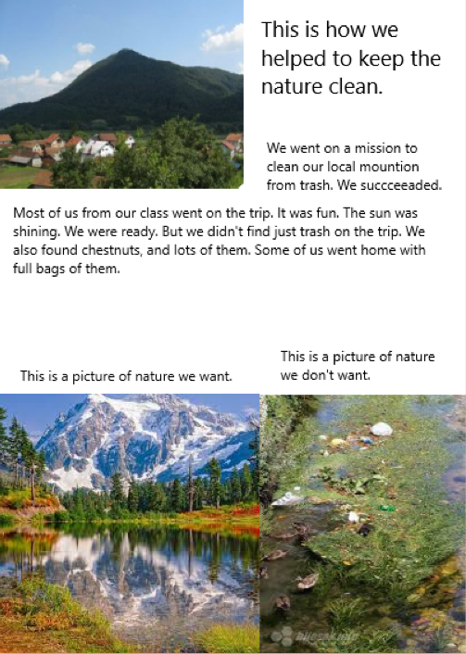
Our small contribution to the preservation of clean mountains
On a sunny autumn day, a group of us headed towards our mountain Ivanščica in an ecological action on the occasion of the World Day of Clean Mountains.
The morning was a little foggy and humid, but then the sun came in so the sky was blue as the sea. The road after leaving Ivanec was easy, until we approached the foot of the mountain, where the terrain became steeper. As soon as we stepped into the woods, we immediately began to breathe easier, but we were all caught up in a sad sight. We saw a lot of garbage. There were cans, boxes, paper, bottles, and even car tires. We got to work and picked up what we could in bags.
The road took us further to the regional school in Prigorac. There we put down the garbage, rested a bit and ate some chocolate, and then headed for the mountain. We watched the clear stream that descended from the mountain near us. It was so clean. We reached a spring with cold and clean water. We drank water and filled our bottles home with it. We were tired and proud of our work, which made us practically aware of the need to preserve clean mountains for the future.
Petar Habek, 7.b

Slide 6
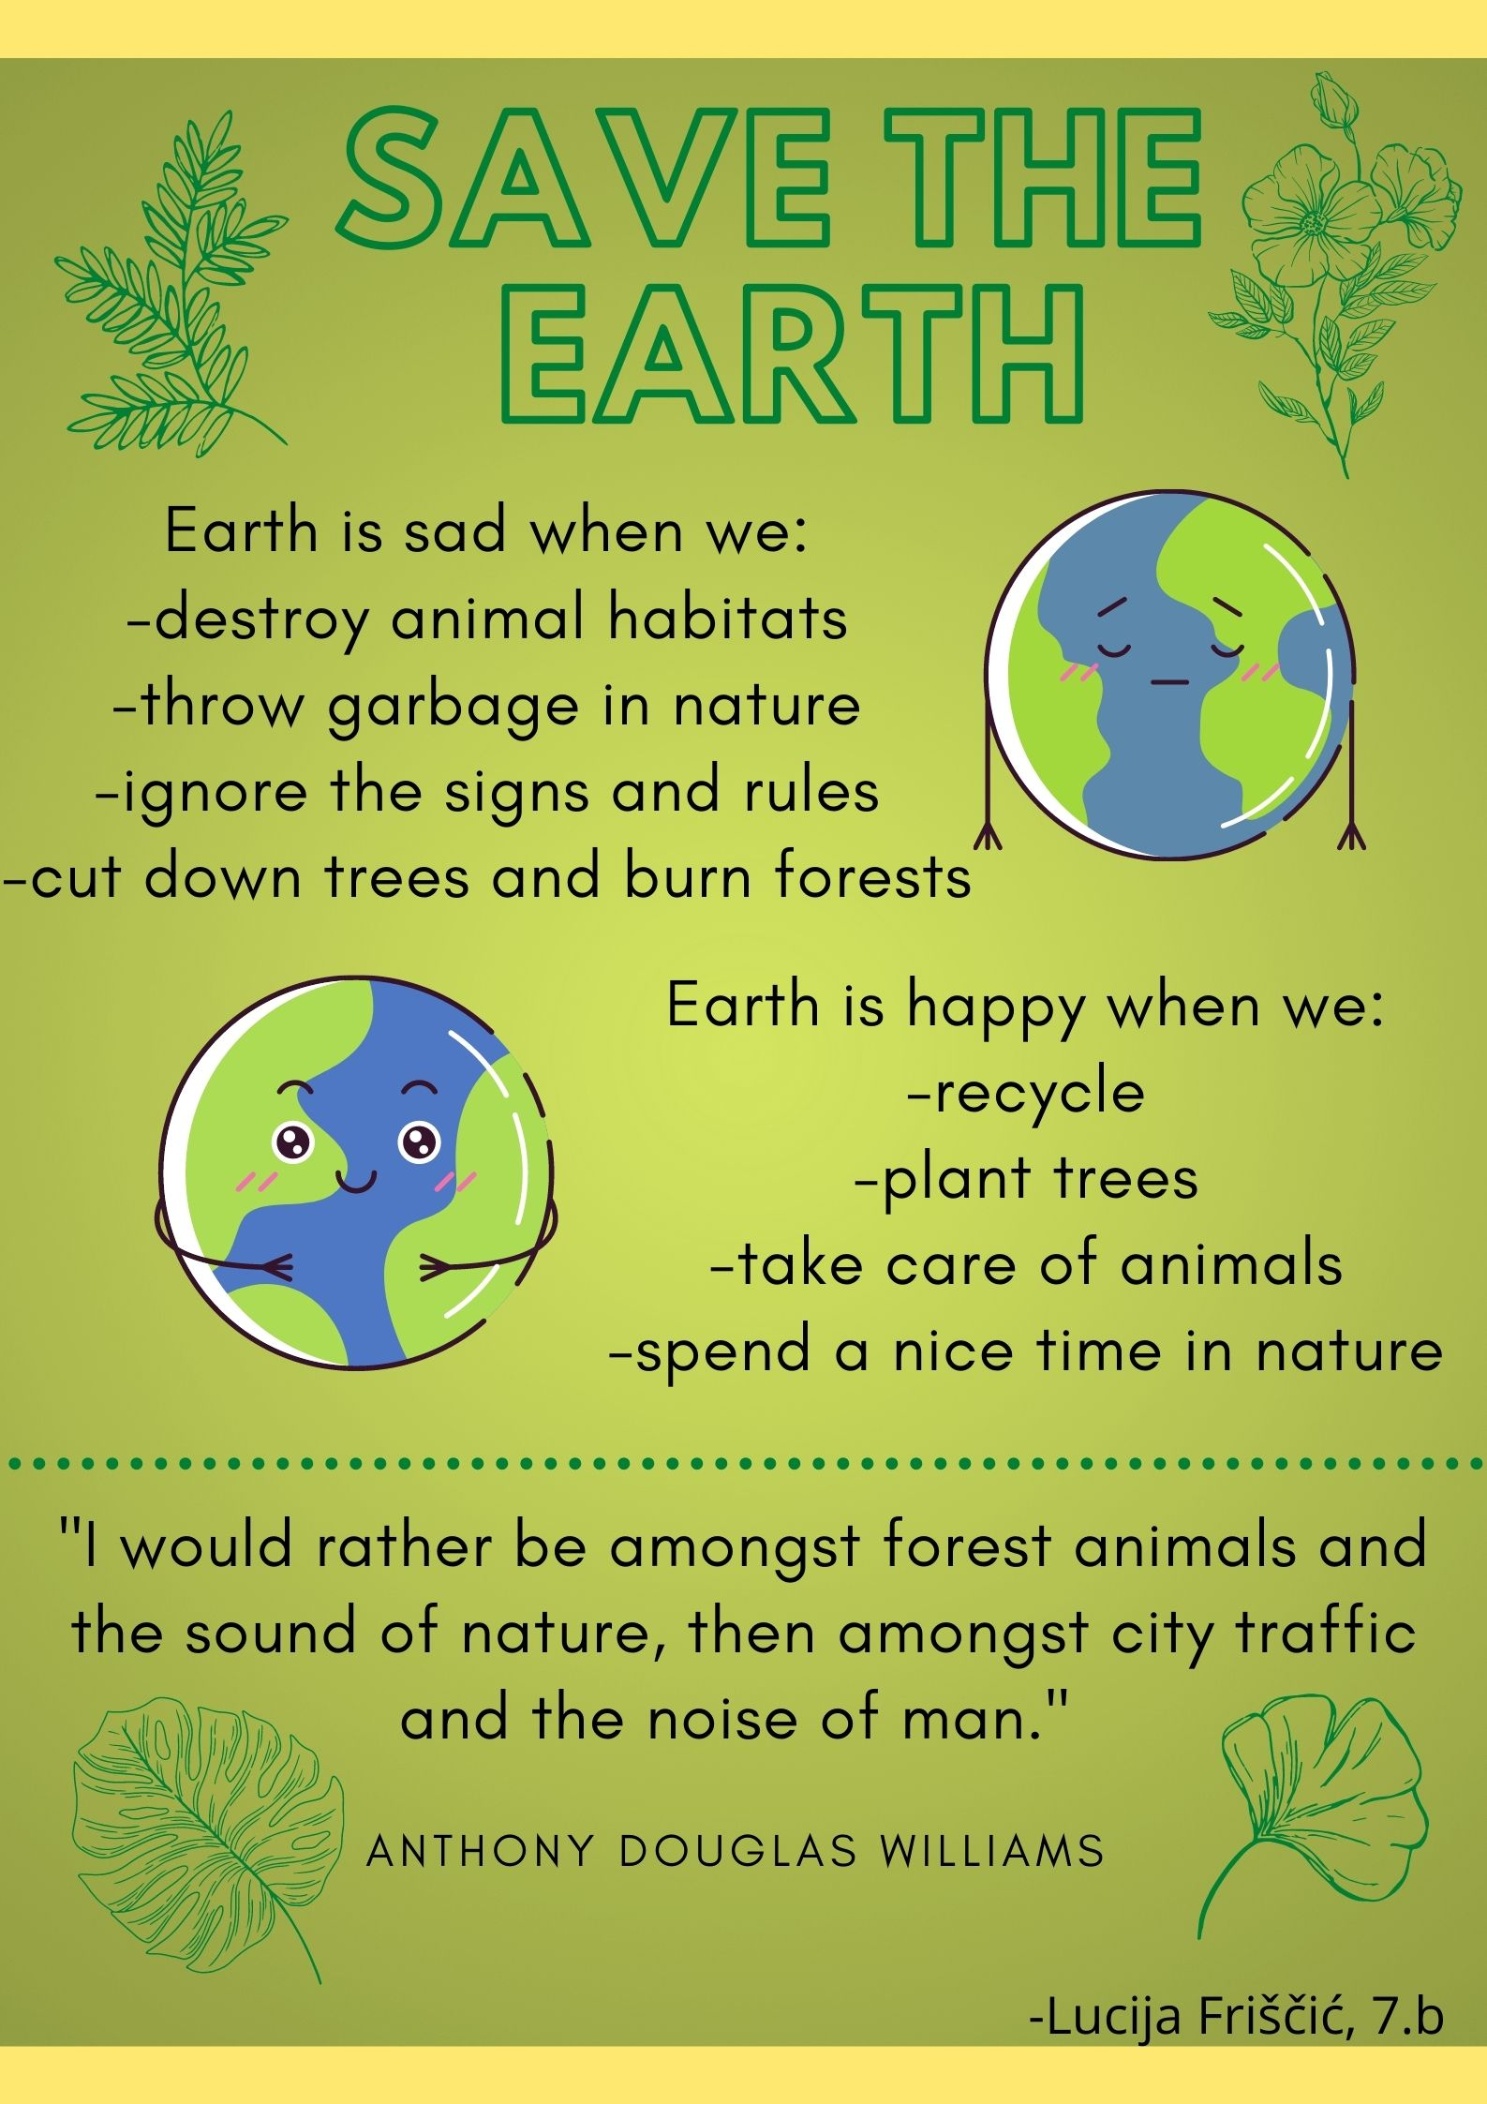

Slide 7
The future of our planet
What will the world look like in the future? I know we will drive different cars, eat different foods, use new technology, but I don’t know what our planet will look like. Will it be greener or full of skyscrapers and large steel buildings?
Our world is already polluted now, and it could be even worse in the future. Or will we have to make an effort? In my opinion, we can change this situation only if we want to. We should protect forests more, our greatest treasure, because they are our source of oxygen. We should purify waters, rivers and lakes, because without clean water no one can live, no man, no animals, no plants. That way we would protect both the seas and the oceans. We should save land and sea from pollution, if we care about our health and the preservation of all plant and animal species on the globe.
We can change the world for the better. Let’s start doing it in small steps! Let's start with ourselves!
Ivan Jurinić, 7.b.

Slide 8
What will be the future of our planet
The Earth gives us water, food, oxygen and all the conditions for life and has done so for many years. We are consuming those resources, and now we have become a bit rude and selfish. We want to live comfortably, so we neglected the Earth's needs.
Because of all the things that hurt her, global warming has happened. Our water tanks have now begun to melt. The time has come for us to start thinking about our future as well as the future of our planet. If we want a harmonious life with the Earth even after twenty years, we must immediately do something to save it. First, we should stop polluting it. Because of its future, we should use our advanced inventions as cleaners.
It doesn't take much to save our Earth. It just takes a lot, a lot of willpower. I think that reason should finally prevail, and with that reason we will preserve our planet for future generations.
Luka Gladović, 7.b.

Slide 9
