Slide 1
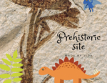
PREHITSORIC
SITE – THE DMANISI SITE
PRESENTATION
BY:
Tea and Lorena 6. a
Primary school Ivanec, Croatia

Slide 2
Is Africa „the cradle of mankind”?
Findings on archeological site near the village Dmanisi in Georgia refer to Eurasian chapter in evolution story about mankind.
The bones found there are around 1.8 million years old - the oldest human remains found outside of Africa.

Slide 3
The international team led by David Lordkipanidze (Director of Georgian National Museum), found the first human jaw in 1991. Since then, until 2007 in Dmanisi have been found fossils of six people. They were given georgian names Zezva and Mzia (Georgian ზეზვა ა მზია). The artists have reconstructed them in order to show how they looked.

Slide 4
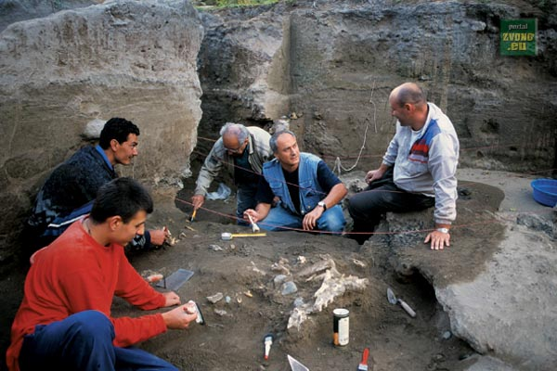

Slide 5
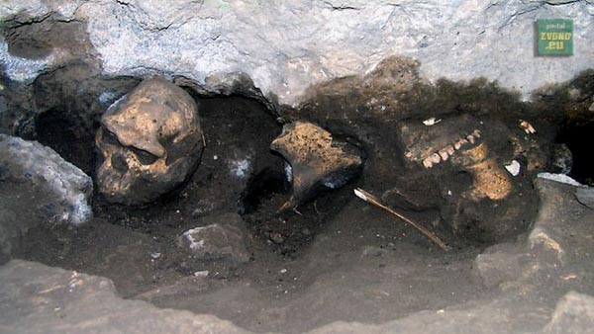

Slide 6
The Early man from Dmanisi was around 4 feet 9 inches tall with small brain, and legs that were more developed than arms which means that he was a good runner.

Slide 7
Prehistoric site
eTwinning project
Mzia i Zezva
Georgia

Slide 8
Thank you for your attention!
https://georgiaabout.com/2012/07/14/about-history-the-oldest-europeans/

